Slide 1
CONFIDENT PEPTIDE–SPECTRUM MATCHING IN THE ABSENCE OF GROUND TRUTH DATA
Wout Bittremieux — TCS Seminar 2023/11/13
@wout@sigmoid.social
bittremieux.be
wout.bittremieux@uantwerpen.be

Slide 2
PROTEINS ARE BUILDING BLOCKS OF LIFE
https://www.khanacademy.org/science/ap-biology/gene-expression-and-regulation/translation/a/intro-to-gene-expression-central-dogma

Slide 3
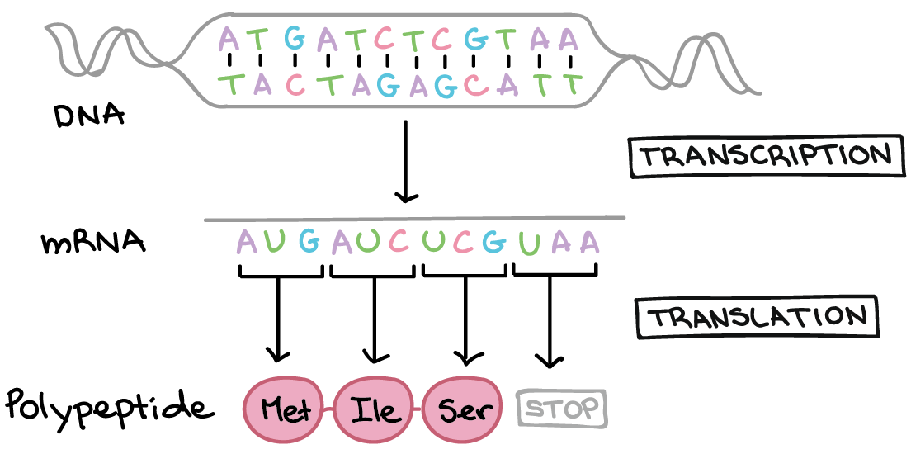
PROTEINS ARE BUILDING BLOCKS OF LIFE
https://www.khanacademy.org/science/ap-biology/gene-expression-and-regulation/translation/a/intro-to-gene-expression-central-dogma

Slide 4
A PROTEIN SEQUENCE
Methionine
Glycine
Alanine
Serine
Tyrosine
Leucine
Arginine
Met
Gly
Ala
Ser
Tyr
Leu
Arg
M
G
A
S
Y
L
R
MGASYLR

Slide 5
DALL-E 3

Slide 7
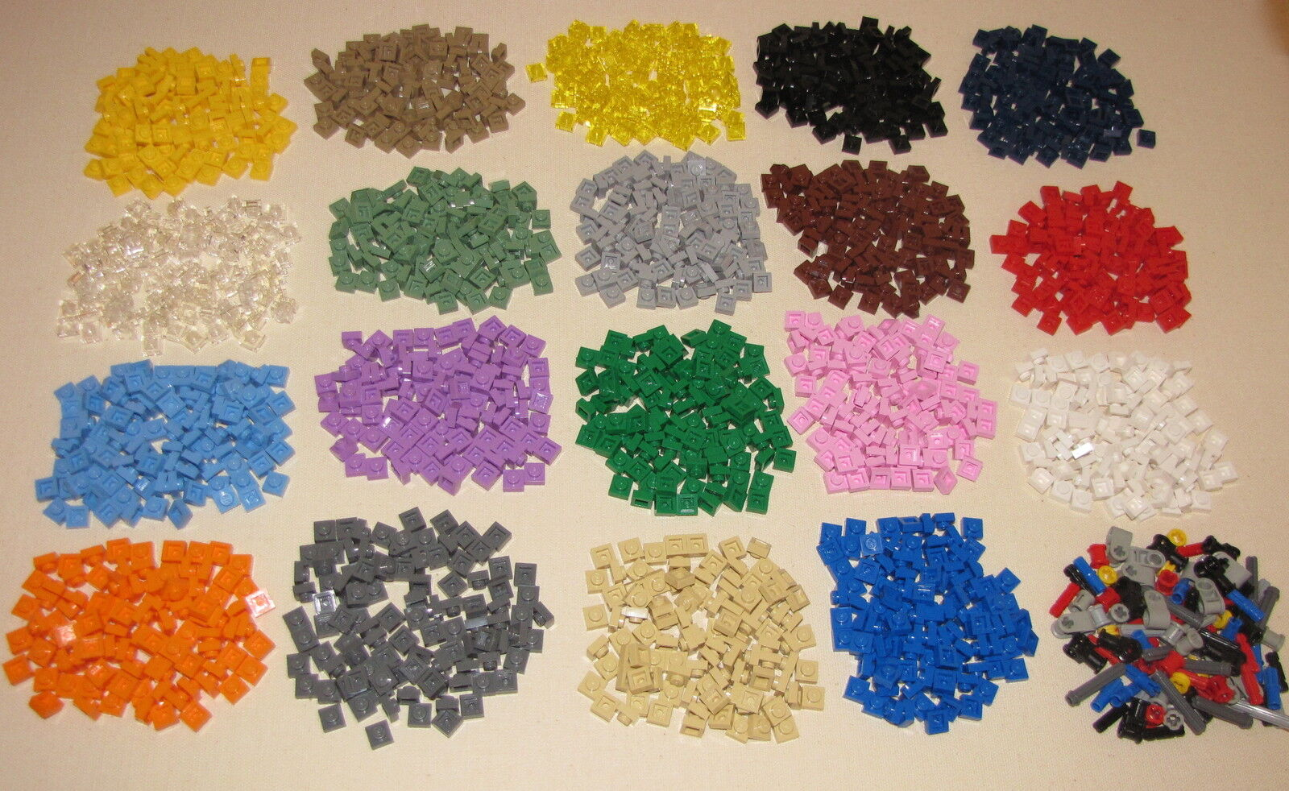

Slide 8
DALL-E 3

Slide 9
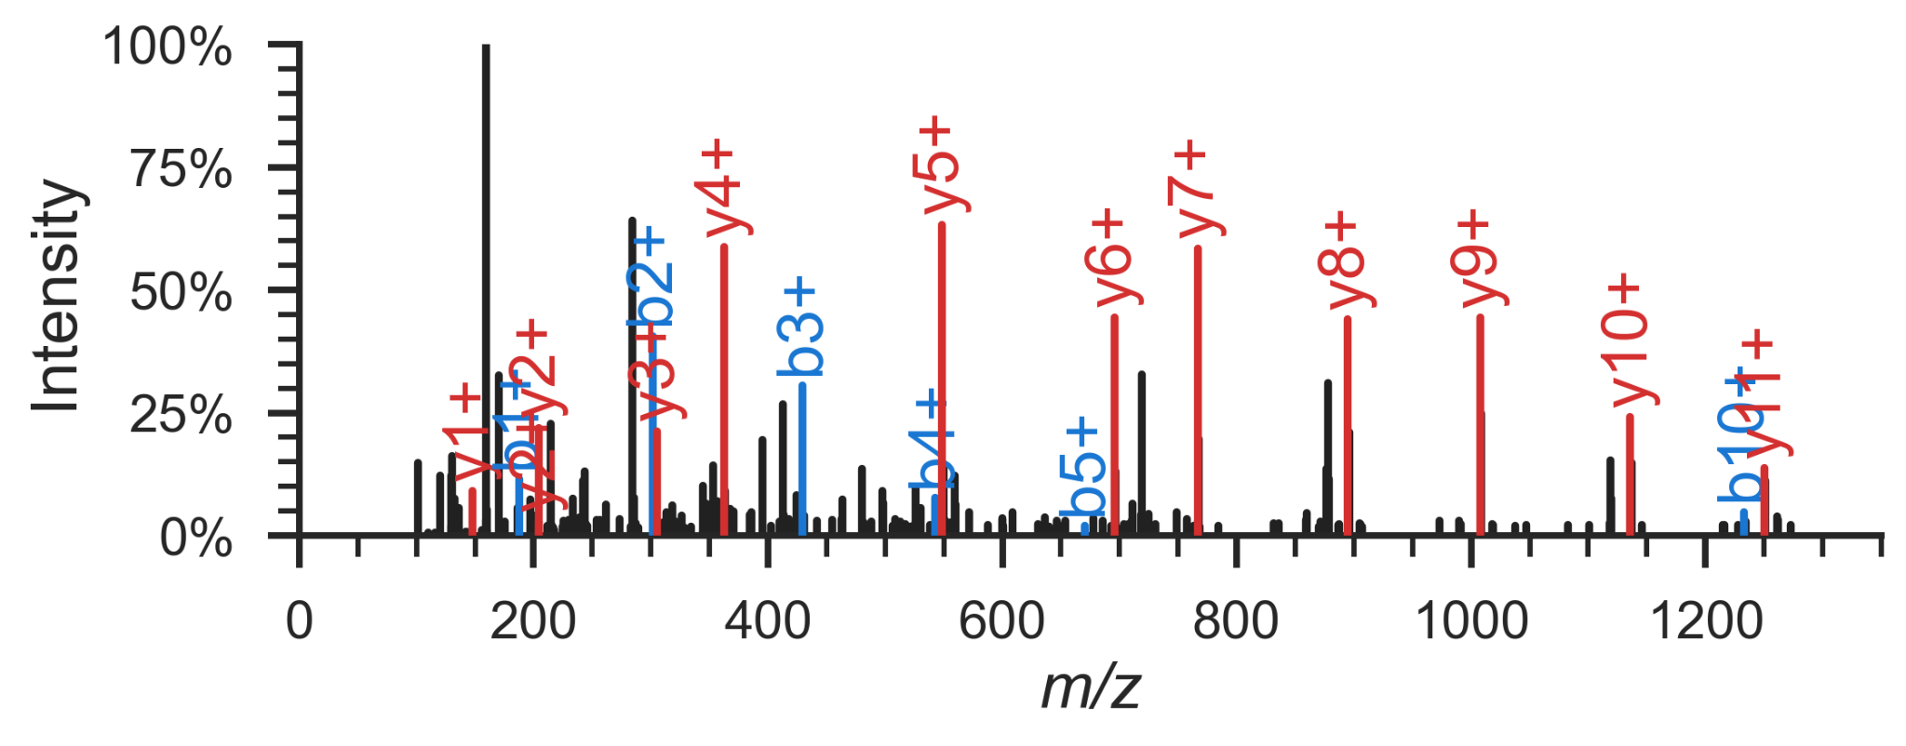
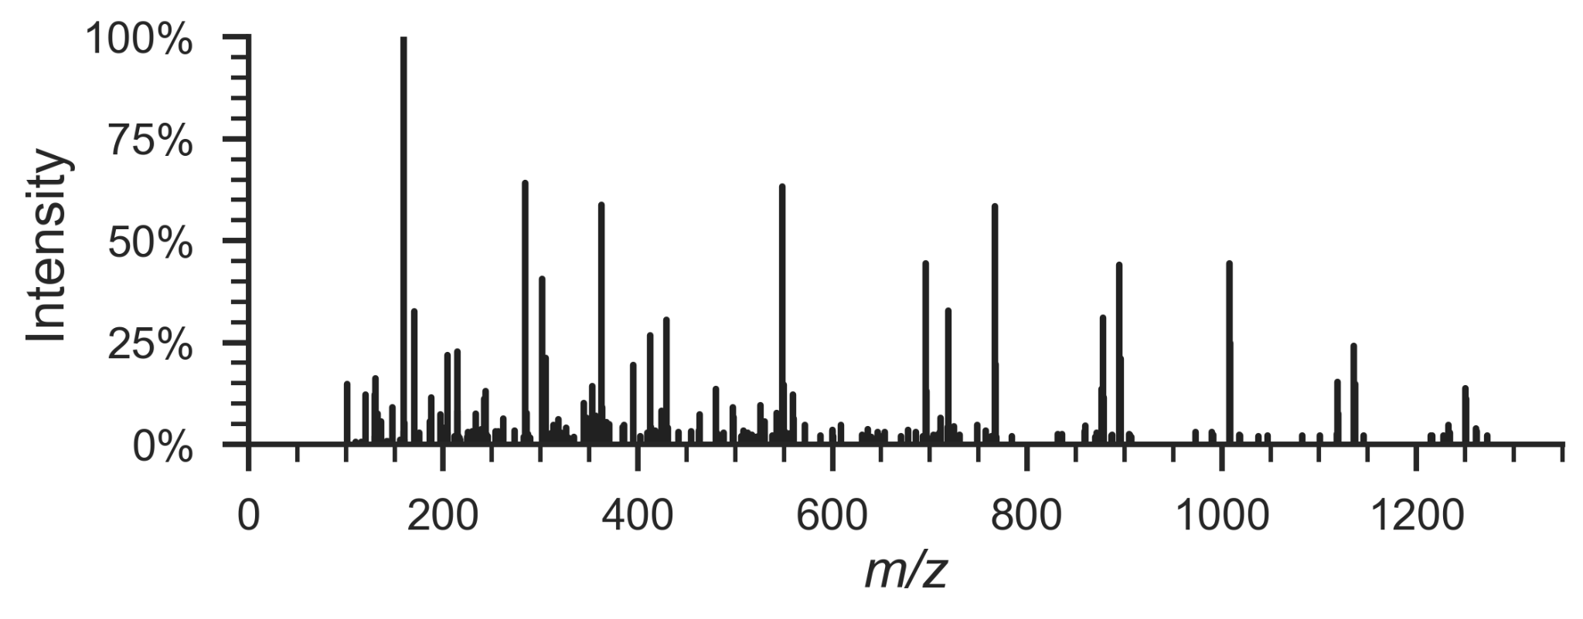
MEASURING PROTEINS USING MASS SPECTROMETRY

Slide 10
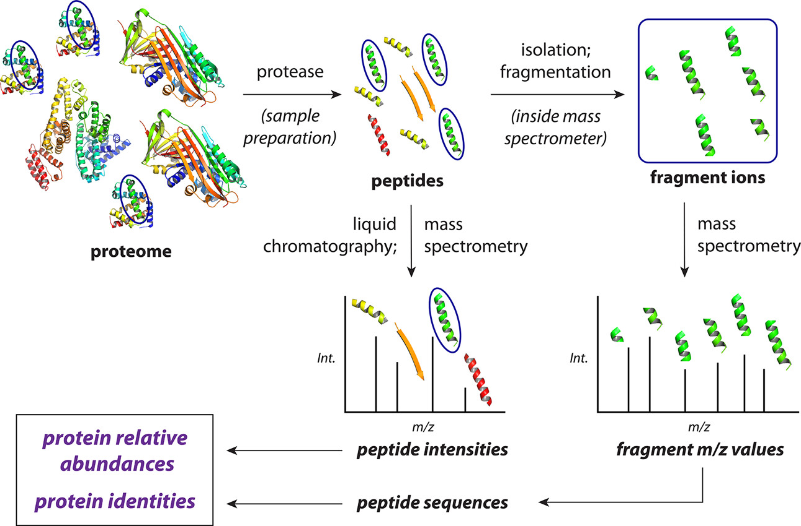
A MASS SPECTROMETRY EXPERIMENT
Shuken, S. An Introduction to Mass Spectrometry-Based Proteomics. Journal of Proteome Research 22 (7), 2151–2171 (2023).

Slide 11
HOW CAN WE GO FROM SPECTRUM TO PEPTIDE?
Shuken, S. An Introduction to Mass Spectrometry-Based Proteomics. Journal of Proteome Research 22 (7), 2151–2171 (2023).

Slide 12
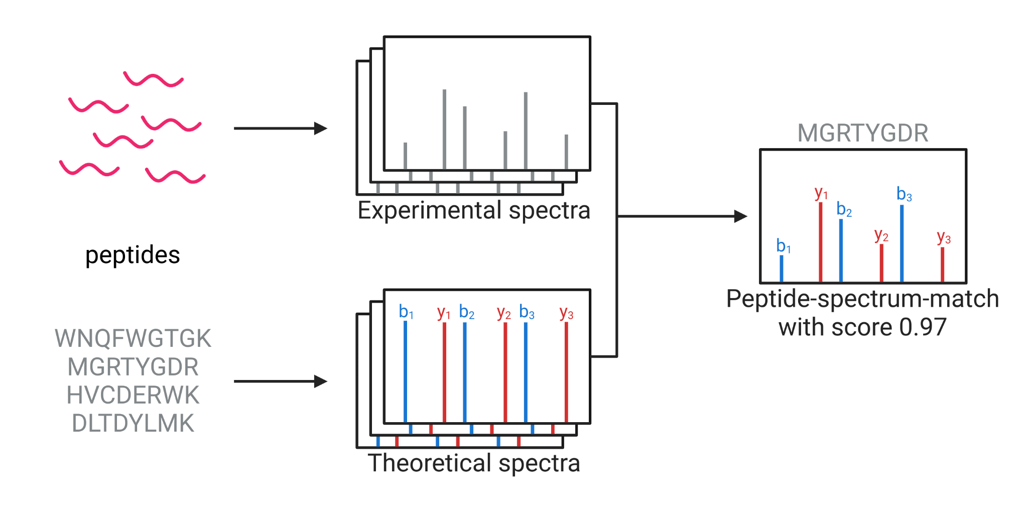
SEQUENCE DATABASE SEARCHING

Slide 13
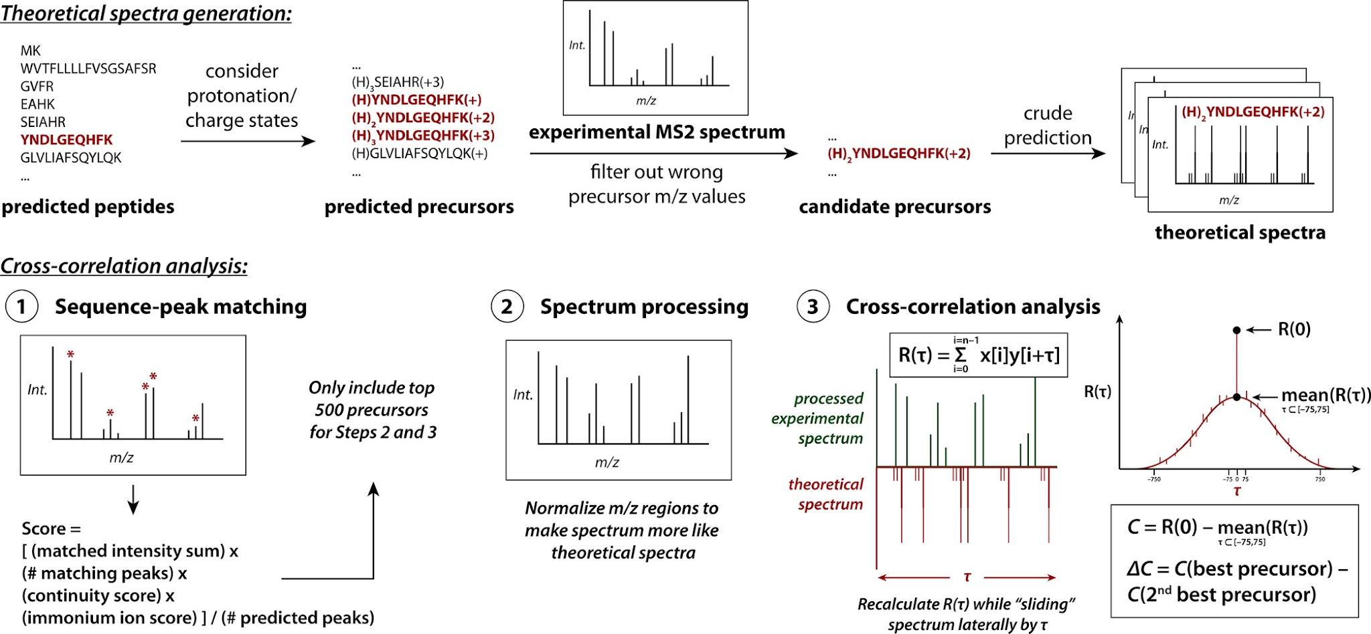
SEQUENCE DATABASE SEARCHING
Shuken, S. An Introduction to Mass Spectrometry-Based Proteomics. Journal of Proteome Research 22 (7), 2151–2171 (2023).

Slide 14
WHAT IS A GOOD PEPTIDE–SPECTRUM MATCH?

Slide 15
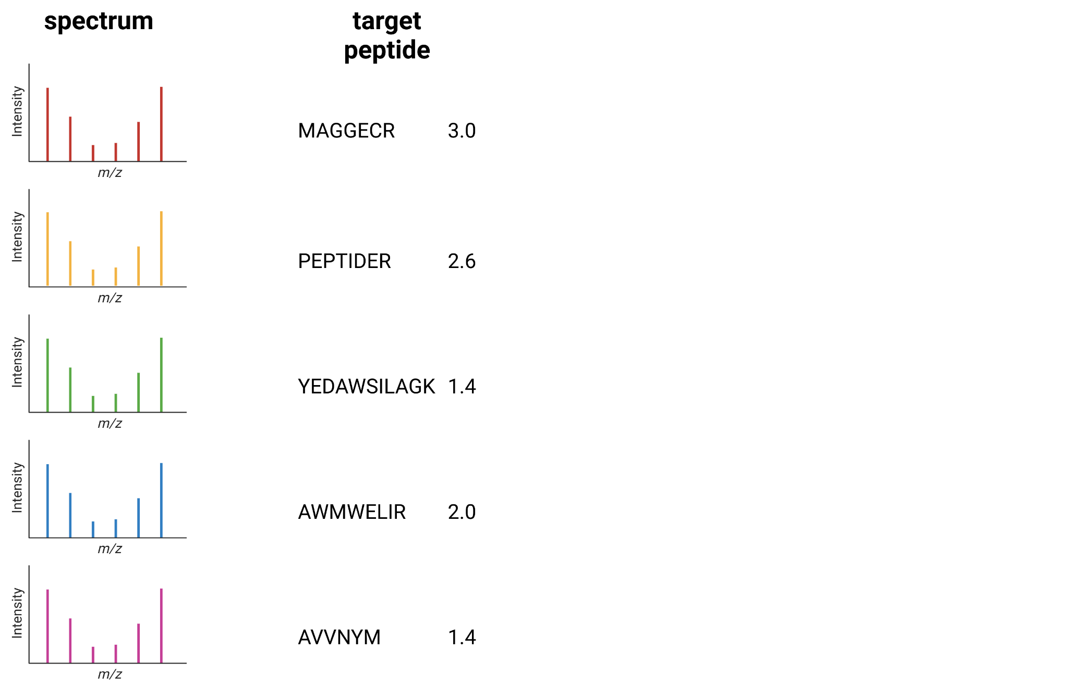
WHAT IS A GOOD PEPTIDE–SPECTRUM MATCH?

Slide 16
TARGET–DECOY COMPETITION
Shuken, S. An Introduction to Mass Spectrometry-Based Proteomics. Journal of Proteome Research 22 (7), 2151–2171 (2023).

Slide 17
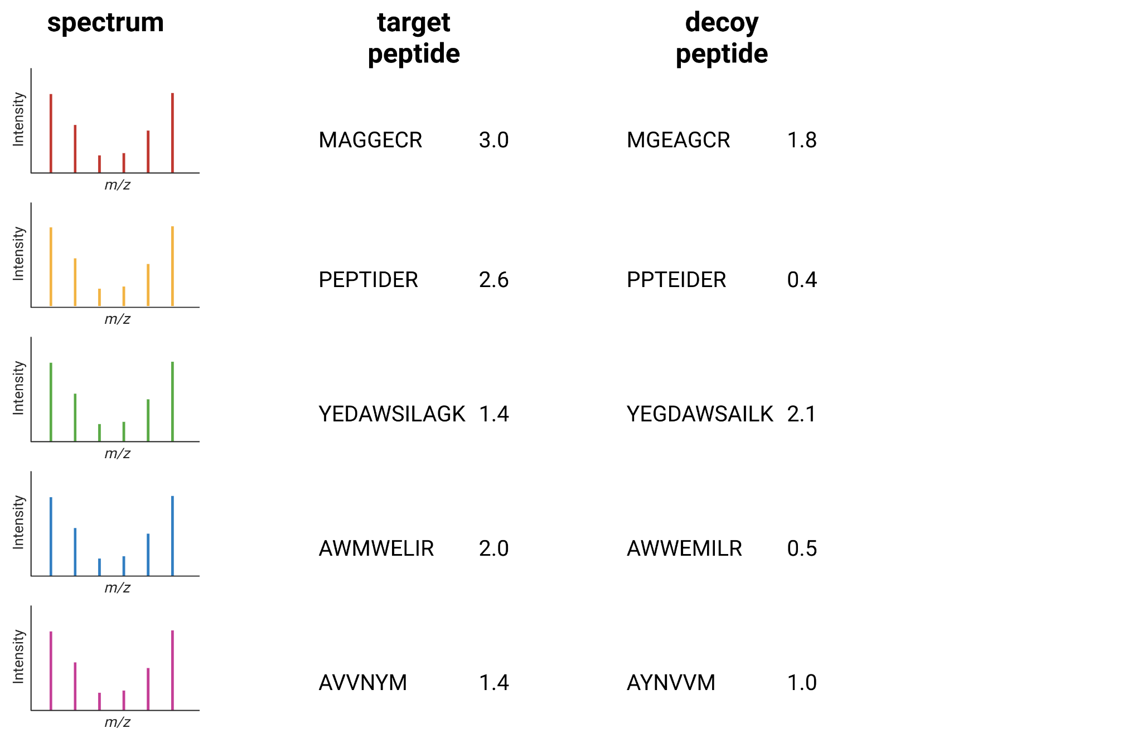
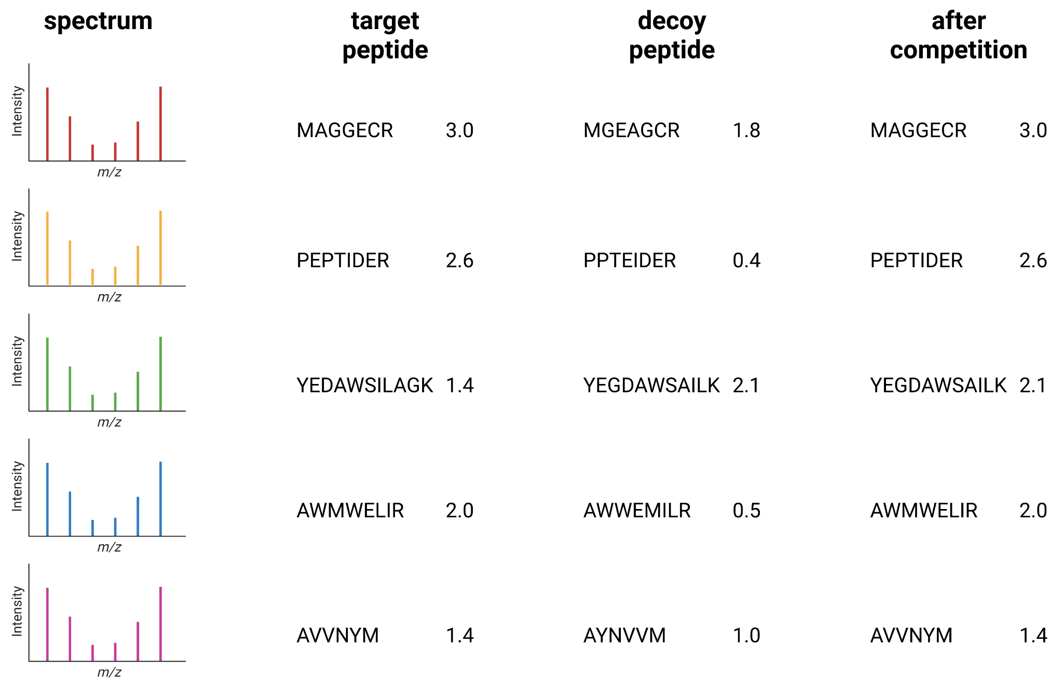
WHAT IS A GOOD PEPTIDE–SPECTRUM MATCH?
Elias, J. & Gygi, S. Target-Decoy Search Strategy For Increased Confidence in Large-Scale Protein Identifications by Mass Spectrometry. Nature Methods 4, 207–214 (2007).

Slide 18
DISTINGUISH BETWEEN TRUE/FALSE POSITIVES?
possibly correct?
decoys
correct

Slide 19
PU LEARNING TO DETECT TRUE POSITIVES
Machine learning features
Search engine score
# matched ions
Δ precursor mass
Peptide length
…
Käll, S. Semi-Supervised Learning For Peptide Identification From Shotgun Proteomics Datasets. Nature Methods 4, 923–925 (2007).

Slide 20
PU LEARNING TO DETECT TRUE POSITIVES
Adams, C. Machine Learning-Based Peptide-Spectrum Match Rescoring Opens Up the Immunopeptidome. PROTEOMICS, in press (2023).

Slide 21
PU LEARNING FOR OPTIMIZED MS DATA ANALYSIS
No ground truth during MS/MS spectrum annotation
Target–decoy competition is used to estimate false discovery rates
PU learning increases the accuracy and sensitivity of sequence database searching
Machine learning-derived features boosts PSM rescoring

